Slide 1


CS214 – Data Structures
Lecture 13: Trees I
Slides by
Mohamed El-Ramly, PhD
Basheer Youssef, PhD
Notes:
Polls in slides:
in lecture 1: 24,29,31,32,42,46
in lecture 2: 65,84,102,103,108,117,130

Slide 2
Agenda
  Introduction to Binary Trees
  Implementing Binary Trees
  Searching Binary Search Trees
  Tree Traversal …1. Breadth-First ….2. Depth-First
  Insertion
  ……1. Deletion by Merging …..2. By Copying
  ……2. Balanced Trees
  .
  Heaps / Heap Sort
  .

Slide 3
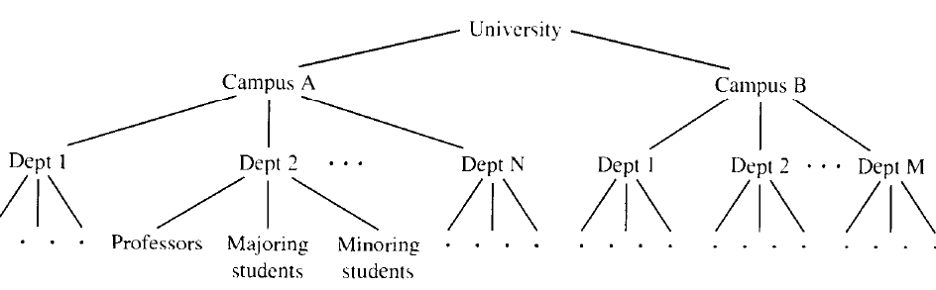
6.1 Trees
Linked Lists are limited, why?
How can I organize a hierarchical structure (of a university for example)

Slide 4
Tree Definitions
A tree data structure consists of nodes and arcs.
Every node has one parent but may have one or more children.
Top node is root. Root has no parent.
Nodes with no children are called leaves.

Slide 5
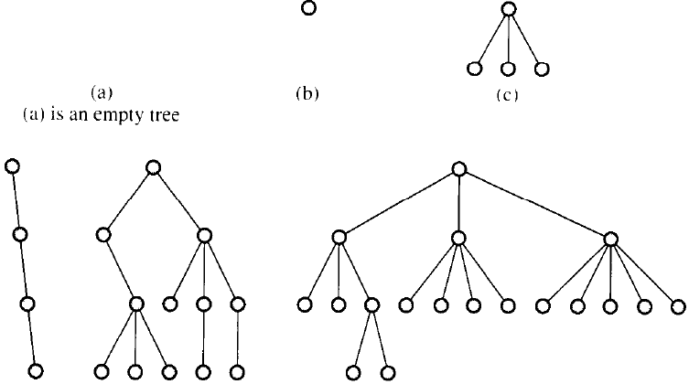

Chapter 6: Binary Trees

Slide 6
Tree Definitions
Each node is reachable from the root with a unique sequence of arcs called path.
The number of arcs in a path is the length of the path.
The level of a node is the length of the path from the root to the node + 1.
The height of a non-empty tree is the maximum level of a node in the tree.

Slide 7
Tree Definitions
The height of an empty tree is zero.
The height of a single node tree is 1.
A single node tree is the only case when the root is also a leaf.
The level of any node is between 1 and the tree height.
In the extreme case, when every node has one child, how will the tree look like?

Slide 8
Binary Trees
A binary tree is a tree whose nodes have at most two children per node.
A complete binary tree is a binary tree that satisfies the following conditions:
  Every non-terminal nodes has 2 children
  Leaves are all at the same level
In a complete binary tree, level i+1has 2^{i} nodes.

Slide 9
Complete Binary Trees
The number of leaves m = 2^{i-1}.
non-terminal nodes k = 2^{i-1} -1.
So, a complete binary tree has 2^{i} -1

Slide 10
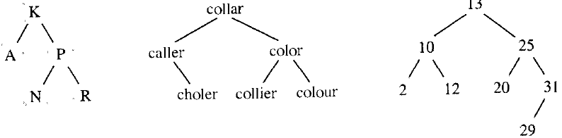
Binary Search Trees
A binary search tree is a binary tree that satisfies the following conditions:
  Every node n in its left sub-tree has a value less than the value stored in n.
  Every node n in its right sub-tree has a value greater than the value stored in n.

Slide 11
6.2 Implementing Binary Trees
How can we implement binary trees ?
Arrays?
  Advantages?
  Limitations?
Linked Structures?

Slide 12
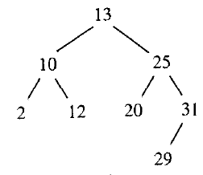
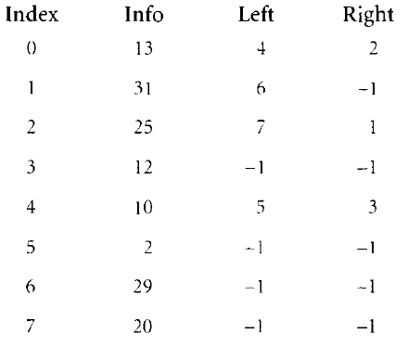
Building Binary Trees w Arrays

Slide 13
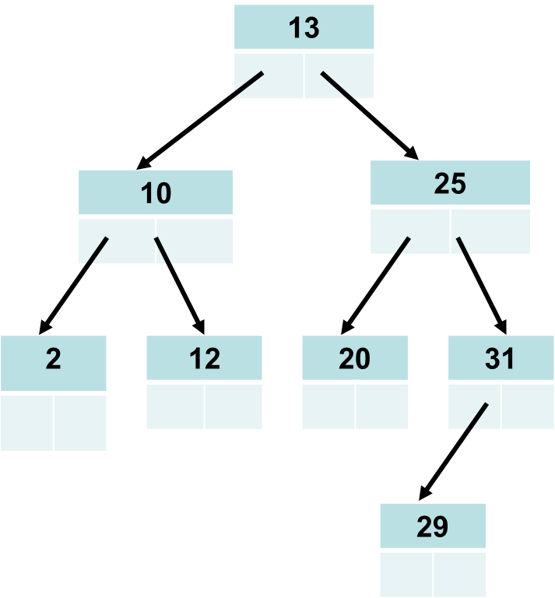
Building Binary Trees w Nodes

Slide 14
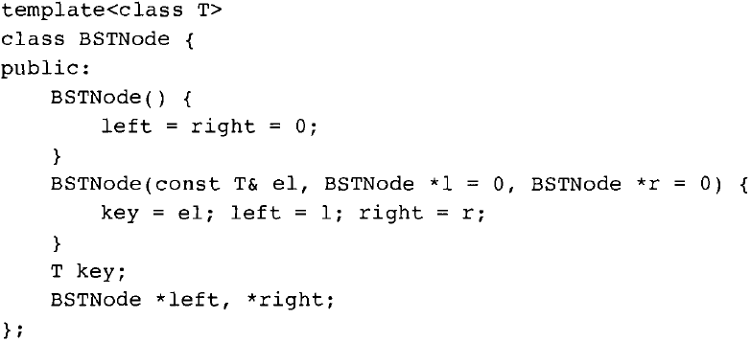
Building Binary Trees w Nodes
(A few comments on style)
private
Chapter 6: Binary Trees

Slide 15
template <class T>
class BSTNode {
private:
T key;
BSTNode* left;
BSTNode* right;
public:
BSTNode () {left = right = 0;}
BSTNode (T& el, BSTNode* l = 0, BSTNode* r = 0){
key = el;
left = l;
right = r;
}
BSTNode* getLeft {return left;}
BSTNode* getRight {return right;}
T getKey {return key;}
}

Slide 16
template <class T>
class BST {
protected:
BSTNode<T>* root
public:
BST () {root = 0;}
void clear() {root = 0;}
bool isEmpty() {retun root == 0;}
T* search (T& el) {
BSTNode<T>* p = root;
while (p != 0)
if (el == p->getKey())
return &p->getKey();
else if (el < p->getKey())
p = getLeft();
else p = getRight();
return 0;
}
}

Slide 17
6.3 Searching in a BST
Trace searching for 1, 12, 31
What is the max num of tests
when searching in this tee?

Slide 18
Complexity of Searching in a BST
Measured by the number of comparisons done, which depends on the nodes encountered on the path from the root to the node searched for.
So, complexity is the length of the path leading to this node +1;
= log n
Worst case = n

